Slide 1

7th Grade Math
Unit 6, Lesson 11 Reasoning Through Problems Involving Proportional Relationships Volume 1, pg. 286

Slide 2


Benchmarks
MA.7.AR.3.2
Apply previous understanding of ratios to solve real-world problems involving proportions.
MA.7.AR.4.5
Solve real-world problems involving proportional relationships.
volume 1, pg. 286

Slide 3
Integrated Mathematical Thinking and Reasoning Standards
MA.K12.MTR.6.1 Assess the reasonableness of solutions.
MA.K12.MTR.7.1 Apply mathematics to real-world contexts.
volume 1, pg. 286

Slide 4

Learning Target
I can solve multi-step problems involving proportions.
volume 1, pg. 286

Slide 5

Warm-Up
volume 1, pg. 287

Slide 6
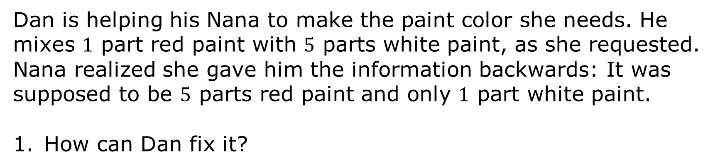
6.11.1 Warm-Up: Mixing Paint
Dan is helping his Nana to make the paint color she needs. He mixes $1$ part red paint with $5$ parts white paint, as she requested. Nana realized she gave him the information backwards: It was supposed to be $5$ parts red paint and only $1$ part white paint.
How can Dan fix it?
volume 1, pg. 287

Slide 7

Collaboration
volume 1, pg. 287

Slide 8

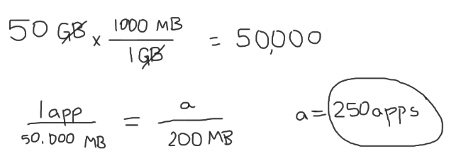
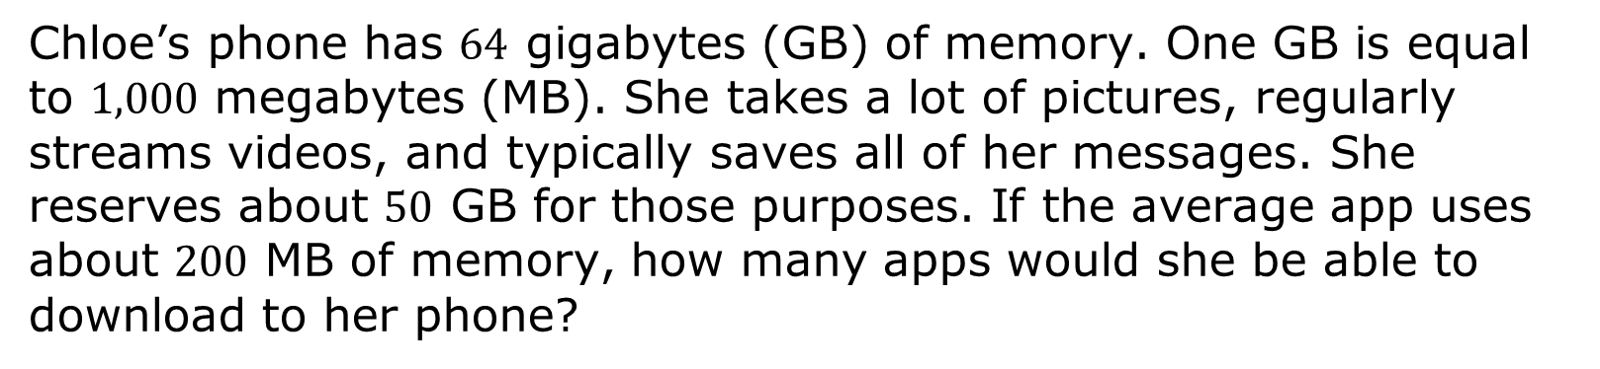
6.11.2 Collaboration: Error Analysis
Chloe’s phone has $64$ gigabytes (GB) of memory. One GB is equal to $1,000$ megabytes (MB). She takes a lot of pictures, regularly streams videos, and typically saves all of her messages. She reserves about $50$ GB for those purposes. If the average app uses about $200$ MB of memory, how many apps would she be able to download to her phone?
volume 1, pg. 287

Slide 9
With your partner, discuss the errors that Chloe made. List the errors.
Help Chloe understand and learn from her mistakes. Write a brief note to Chloe explaining what her mistakes were and how she could learn from them.
Work with your partner to determine how many apps Chloe would be able to download to her phone.
volume 1, pg. 287

Slide 10

Bring It Together
volume 1, pg. 288

Slide 11

6.11.3 Bring It Together: Solving Multi-Step Problems
Consider some of the problems you’ve solved and errors you’ve made over the last few lessons.
What are some strategies you have learned and key tips that are helpful for you to keep in mind when solving multi-step problems?
Helpful Tips | Strategies
volume 1, pg. 288

Slide 12
Compare and discuss your list with your partner. Add any tips or strategies your partner shares to your list that you find helpful.
volume 1, pg. 288

Slide 13

Your Turn
volume 1, pg. 288

Slide 14

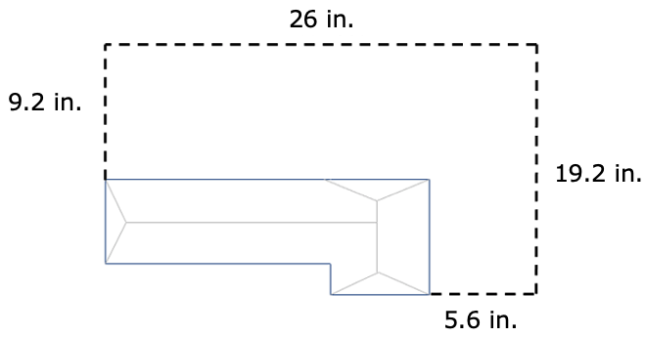
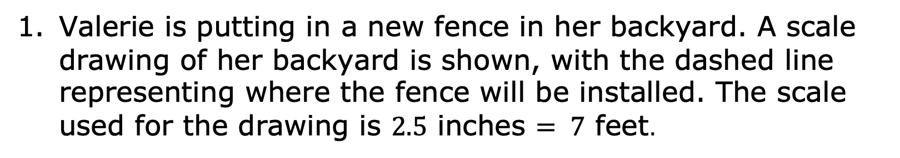
6.11.4 Your Turn!
Valerie is putting in a new fence in her backyard. A scale drawing of her backyard is shown, with the dashed line representing where the fence will be installed. The scale used for the drawing is $2.5$ inches $= 7$ feet.
not drawn to scale
volume 1, pg. 288

Slide 15
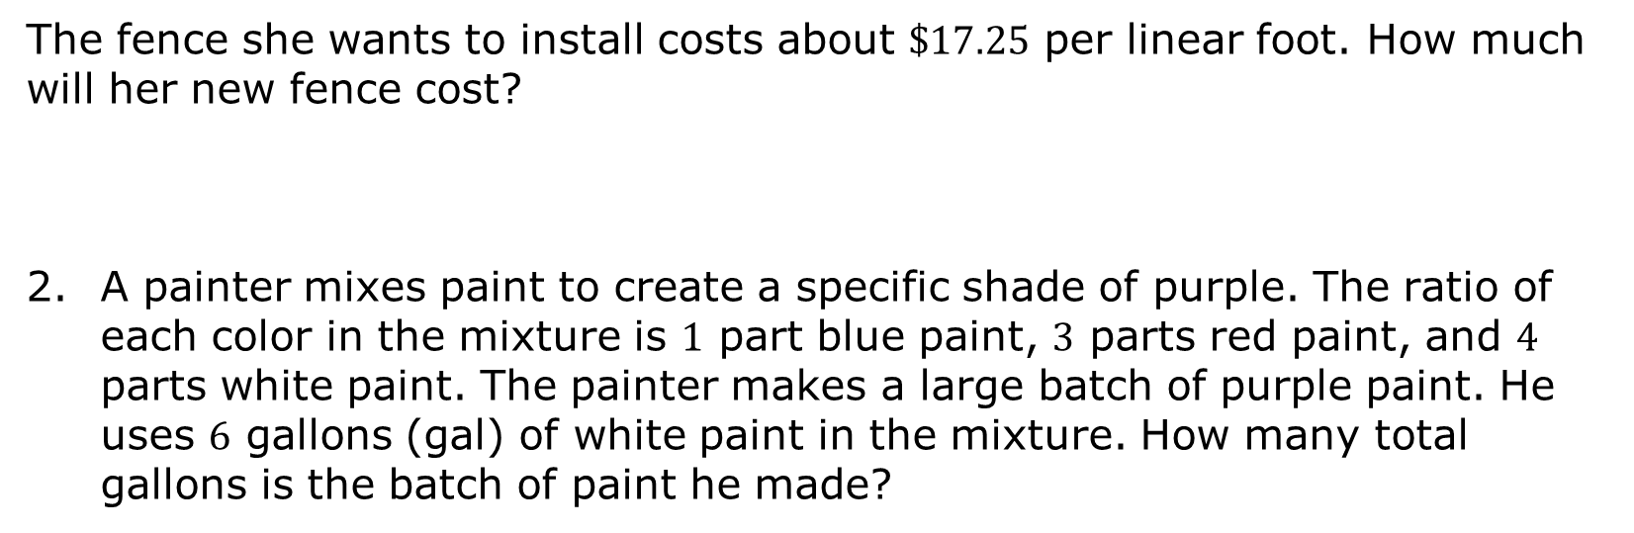
The fence she wants to install costs about $\$17.25$ per linear foot. How much will her new fence cost?
A painter mixes paint to create a specific shade of purple. The ratio of each color in the mixture is $1$ part blue paint, $3$ parts red paint, and $4$ parts white paint. The painter makes a large batch of purple paint. He uses $6$ gallons (gal) of white paint in the mixture. How many total gallons is the batch of paint he made?
volume 1, pg. 288

Slide 16
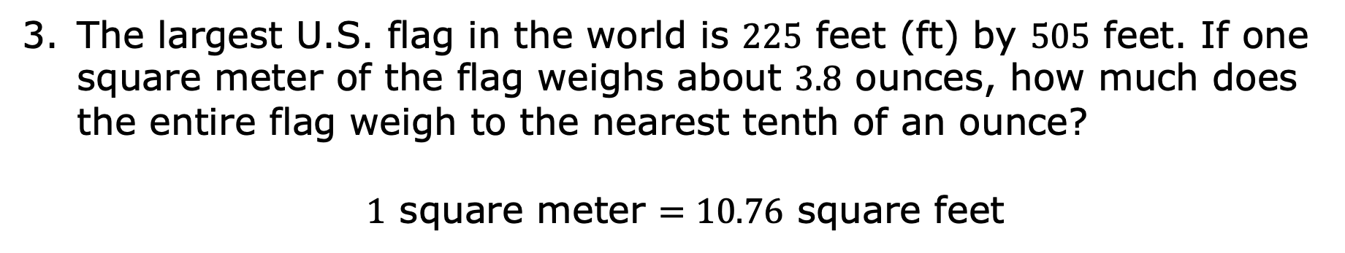
The largest U.S. flag in the world is $225$ feet (ft) by $505$ feet. If one square meter of the flag weighs about $3.8$ ounces, how much does the entire flag weigh to the nearest tenth of an ounce?
$1$ square meter $=10.76$ square feet
volume 1, pg. 289

Slide 17

Paul has determined that the number of calories in a $2$-scoop serving of ice cream is $375$ calories. Paul has $1\frac{1}{2}$ scoops of ice cream $4$ days a week. How many calories from ice cream does Paul eat in a week?
Maylisa averages $3,247$ steps for $1.4$ miles (mi). She can walk $3.2$ miles in an hour. How many steps can Maylisa walk in $90$ minutes?
volume 1, pg. 289

Slide 18

Rishi and Diego are each making orange juice. Rishi mixes $2\frac{1}{2}$ cups (c) of water with $\frac{1}{3}$ cup of orange juice concentrate. Diego mixes $1\frac{2}{3}$ cups of water with $\frac{1}{4}$ cup of orange juice concentrate.
Will their orange juices taste the same? Explain.
There are $16$ cups in one gallon (gal). How much concentrate should each of them mix with $2$ gallons of water to make juice that tastes the same as their original recipe?
volume 1, pg. 289

Slide 19

Wrap-Up
volume 1, pg. 290

Slide 20

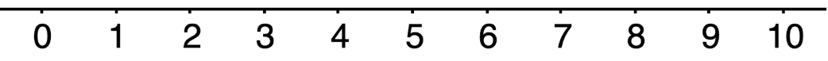
6.11.5 Wrap-Up: Reflection
Consider the learning target from the last few days and mark where you are on the smiley-face scale.
I can solve multi-step problems involving proportions.
Explain why you marked yourself where you did.
volume 1, pg. 290

